Slide 1

Text Classification for Spam Detection and Comparison Analysis

Slide 2
Table of Content
Problem identification
Recommendation and key findings
Modeling results and analysis
Summary and conclusion

Slide 3
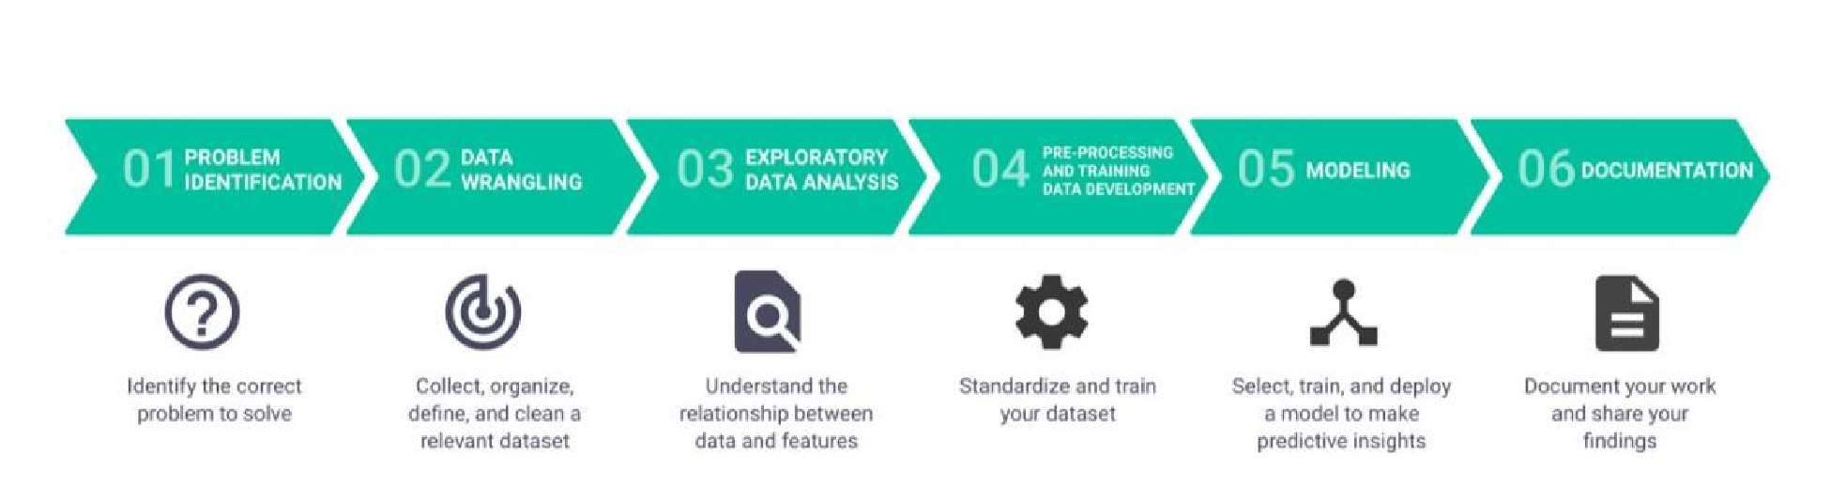
Data Science Methodology:
We have worked through each step of the data science method to complete the capstone project

Slide 4
Problem Identification:
Spam messages are pervasive across email, messaging apps, and other communication platforms. Accurate detection is crucial to filter out unwanted content and enhance the overall user experience
Context:
The project targets creating a robust and versatile model that can generalize well to different types of spam messages.

Slide 5
Success Metrics:
Achieve high accuracy in distinguishing between ham and spam messages.
Develop interpretable models for analysis and insights.
Implement three different models for performance analysis.
Compare and contrast the effectiveness of Naive Bayes, Random Forest, and Neural Network models.

Slide 6
Stakeholders:
End-users who will benefit from reduced exposure to spam.
Communication platform providers seeking improved spam filters.
Researchers and data scientists exploring diverse text classification techniques.
Data Sources:
The project will utilize a Kaggle dataset containing labeled examples of spam and ham messages. The dataset will be preprocessed to extract relevant features and ensure compatibility with the chosen models.

Slide 7

Problem Statement
The proliferation of spam messages in communication channels poses a significant challenge, leading to user inconvenience, privacy concerns, and potential security threats. The aim of this project is to develop an efficient text classification model for spam detection, leveraging various techniques, including Bag of Words (BoW), TF-IDF, Word2Vec, and advanced BERT embeddings.

Slide 8
EDA and Data Preprocessing

Slide 9
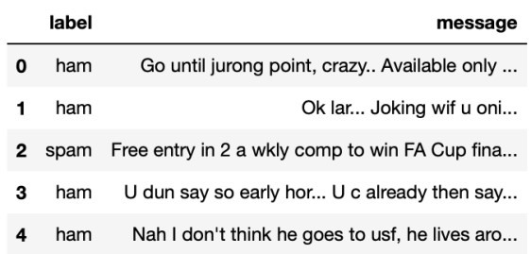
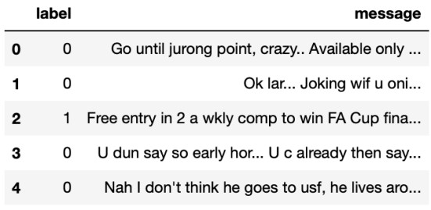
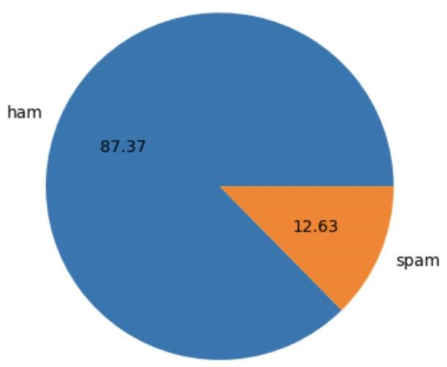
Dataset includes 4825 Ham messages and 747 Spam messages.
87.37% ham and 12.63% spam messages.

Slide 10
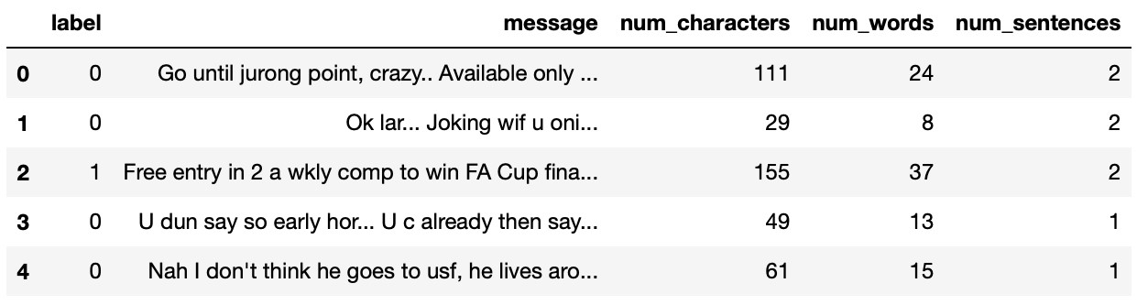
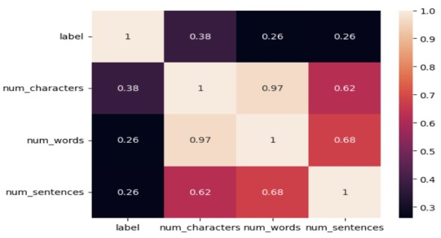
Created three new columns ie Number of Characters, Number of Words and Number of Sentences for further Analysis
Created a heatmap to find any correlations.

Slide 11
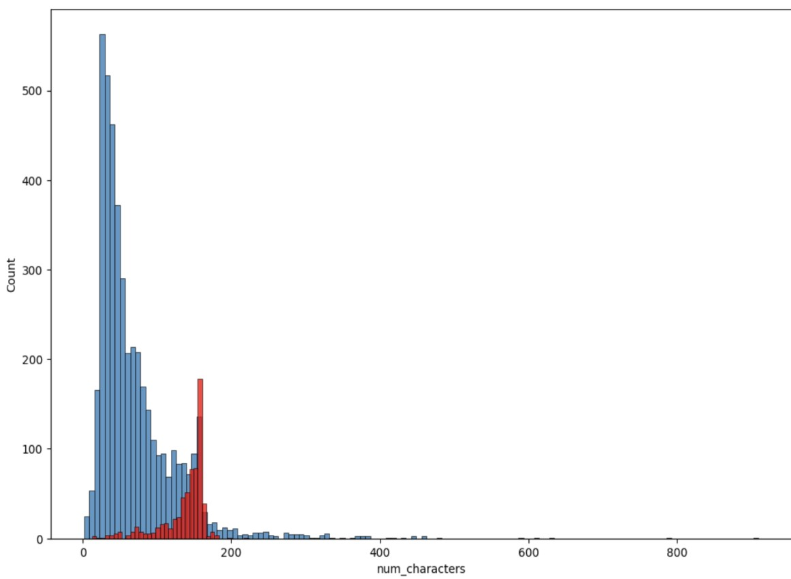
Number of Characters are the most correlated feature, so we plotted a histogram to check the trends in Ham and Spam messages. Our Histogram shows that there are 3 times more characters in ham messages than spam.
Ham = Blue and Spam = Red

Slide 12
Modeling
Trained three different models for Comparison Analysis
Naive Bayes using BoW and Tfidf
Random Forest using Word2vec
Neural Network using BERT

Slide 13
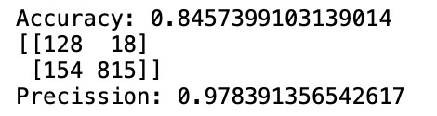
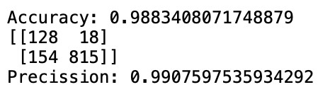
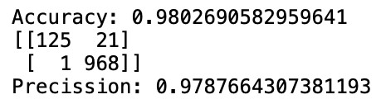
Naive Bayes Evaluation Matrix:
Gaussian Naive Bayes
Best results of 98% Accuracy and 99% Precision from Multinomial Naive Bayes model
Multinomial Naive Bayes
Bernoulli Naive Bayes

Slide 14
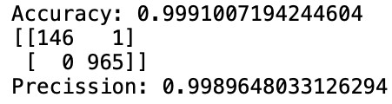
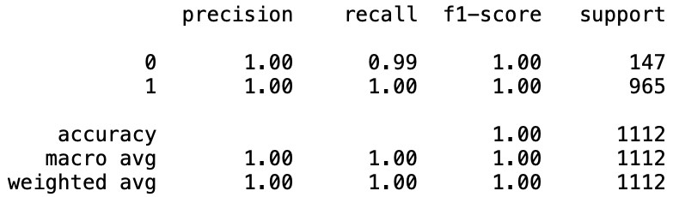
Random Forest Evaluation Matrix:
We got an accuracy of 99% and a precision of 99%.

Slide 15
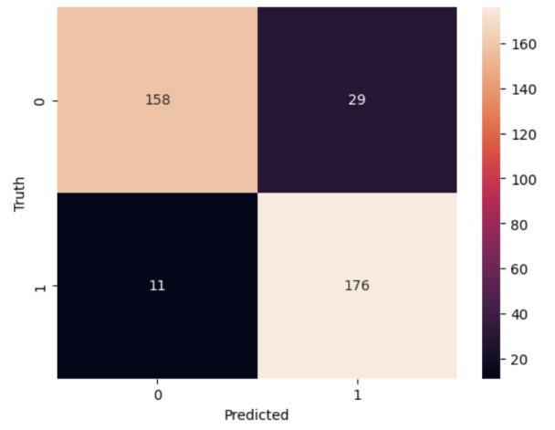
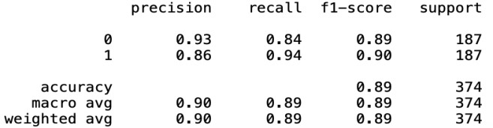
Evaluation Matrix for our Neural Network using BERT

Slide 16

Comparison Analysis Results
Best results of 98% Accuracy and 99% Precision from Multinomial Naive Bayes model
We got an accuracy of 99% and a precision of 99% from Random Forest Classifier.
Neural Network using BERT has a Precision of 94% which is not really good.
Our best model with a Precision and Accuracy of 99% is Random Forest using Word2vec.

Slide 17

Conclusion:
In this Capstone project, Text Classification for Spam Detection we worked through a series of tasks such as Data Collection, Data Preprocessing, EDA and Modeling. We performed different NLP techniques and created three models:
Naive Bayes We Created a Naive Bayes model using Bag of Words (BoW), Multinomial Naive Bayes model using CountVectorizer with Max_features = 3000 gave the best results with an Accuracy of 98% and Precision of 99%.
Random Forest We Got some amazing results from our Random Forest model by training a word2vec from scratch. We got an Accuracy of 99% and a Precision of 99%.
Neural Network We created a single layer neural network using Bert embedding ( pre-trained model ). Didn't get very good Precision score as we're looking for precision here.

